Slide 1

RSVP MOVIES – SQL PROJECT
By Revanth

Slide 2
Introduction
RSVP Movies is an Indian movie production company which has produced many super-hit films. They have normally launched films for the Indian audience, however for their subsequent project, they're making plans to launch a film for the worldwide target market in 2025.
Objective: As data analysts, we have provided data on movies released over the past three years. We need to provide meaningful data information and assists them to start a new movie project.

Slide 3
Data Description
Genre, movie, names, role_mapping, ratings and director_mapping are the 6 tables that make up the database.
movie Table
columns | 9
primary key | id
rows of data | 7997
genre Table
columns | 2
primary key | Movie_id, genre
rows of data | 14662
names Table
columns | 5
primary key | id
rows of data | 25735
role_mapping Table
columns | 3
primary key | Movie_id, name_id
rows of data | 15615
director_mapping Table
columns | 2
primary key | Movie_id, name_id
rows of data | 3867
ratings Table
columns | 4
primary key | Movie_id
rows of data | 7997

Slide 4
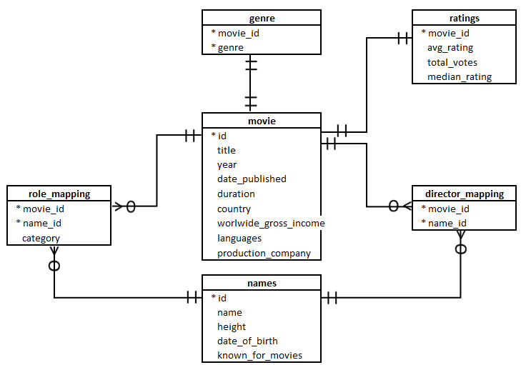
ERD Diagram

Slide 5
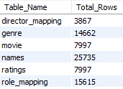
Data Analysis and Insights
1. Total number of rows in each table
2. Columns with null values in ‘movie’ table
Observation: In movie table, country, worlwide_gross_income, languages, production_company columns have null values.

Slide 6
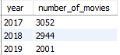
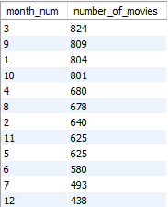
Data Analysis and Insights
3. Number of Movies released in each year.
Observation: 3052 movies were released in 2017. This is the highest value from 2017 to 2019.
Observation: 824 movies were released in march alone. It is highest among month – wise movie distribution
Since December is the month with the lowest movie release market share as well as Christmas, New Year and many other holidays, RVSP producers should plan to release movies around December.
Movies Month wise trends

Slide 7
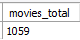
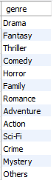
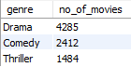
Data Analysis and Insights
4. Total Movies produced in the USA or India in the year 2019.
Observation: Some films are even produced in multiple countries. So, the total combination of filmmaking in India or USA for year 2019 is 1059.
5. List of Total Genres present in ‘genre’ dataset.
Observation: Total 13 different genres exist in dataset.
6. Top 3 genres with the highest total number of films produced
Observation: Dramas accounted for the highest proportion with 4,285 films produced from year 2017-19.

Slide 8

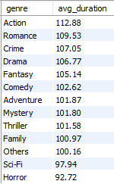

Data Analysis and Insights
7. Total Number of Movies belong to only 1 genre.
Observation: Over 3000 movies belong to only 1 genre.
8. Average duration of movies in each genre.
Observation: Action films have the longest average length but are not in the top 3 most produced film genres. Dramas lead in the number of films produced but are 4th in the average length list.
9. Rank of the ‘thriller’ genre of movies among all the genres in terms of number of movies produced
Observation: Thriller genre is in top 3 among all genres in terms of movie count.

Slide 9
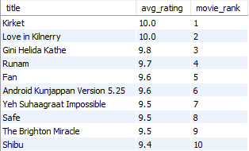
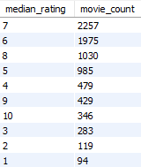
Data Analysis and Insights
10. The minimum and maximum values in each column of the ratings table.
11. Top 10 movies based on average rating.
12. Ratings table based on the movie counts by median ratings
Observation: Both Kirket and Love in Kilnerry have an average rating of 10.
Observation: The average rating of 7 represents the highest percentage of movies.

Slide 10
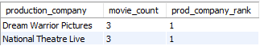
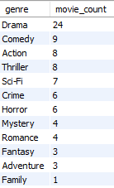
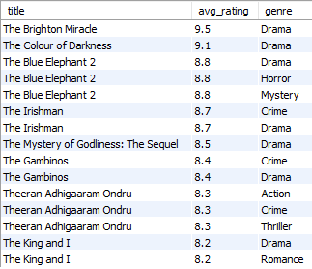
Data Analysis and Insights
13. Production house - produced the most number of hit movies (average rating > 8).
Observation: Both Dream Warrior Pictures and National Theatre Live have produced most hit movies. RVSP may have potential partners for film production.
14. Movies released in each genre during March 2017 in the USA had more than 1,000 votes.
15. Movies of each genre that start with the word ‘The’ and which have an average rating > 8
Observation: Dramas were once again the most popular movies of March 2017 in the US.

Slide 11
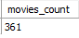
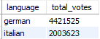

Data Analysis and Insights
16. Movies released between 1 April 2018 and 1 April 2019, have median rating of 8.
Observation: Total 361 movies were released in FY2019 having median rating of 8.
17. German movies get more votes than Italian movies ! True or False
Observation: True, German movies more popular than Italian movies based on total votes.
18. Columns with null values in the ‘names’ table.
Observation: Except name column, all tables have null values.

Slide 12
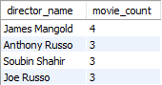
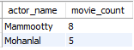

Data Analysis and Insights
19. The top three directors in the top three genres whose movies have an average rating > 8.
Observation: James Mangold, Anthony Russo and Soubin Shahir are the top 3 directors in top 3 genres whose movies have an average rating > 8.
20. The top two actors whose movies have a median rating >= 8.
Observation: Mammootty and Mohanlal are the 2 top actors whose movies have an median rating >= 8 .
21. The top three production houses based on the number of votes received by their movies
Observation: Marvel Studios, Twentieth Century Fox are the most popular production houses.

Slide 13
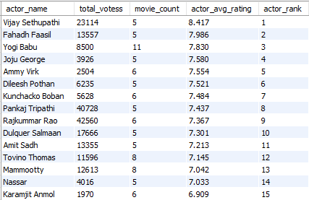
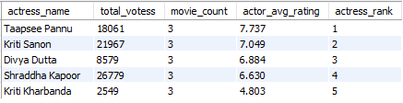
Data Analysis and Insights
22. Rank actors with movies released in India based on their average ratings
23. The top five actresses in Hindi movies released in India based on their average ratings?
Observation: Taapsee Pannu is at the top of actresses list.
Observation: Vijay Sethupathi is at the top of actors list.

Slide 14
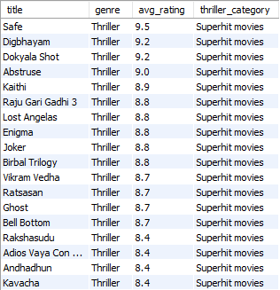
Data Analysis and Insights
24. Classify thriller movies as per avg rating and classify them in the following category:
Rating > 8: Superhit movies
Rating between 7 and 8: Hit movies
Rating between 5 and 7: One-time-watch movies
Rating < 5: Flop movies
Observation: It is observed that most of the thriller movies are mostly One-time-watch movies as rating got between 5 and 7.

Slide 15
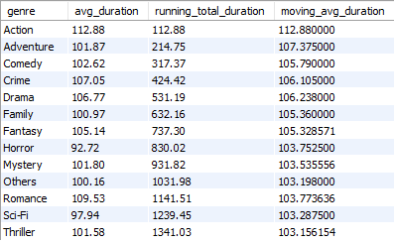
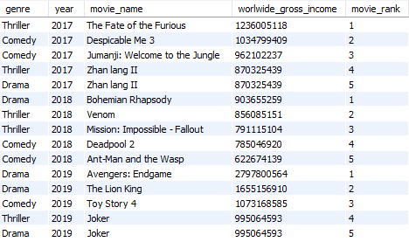
Data Analysis and Insights
25. The genre-wise running total and moving average of the average movie duration.
26. The five highest-grossing movies of each year that belong to the top three genres.
Observation: It is observed that thriller has highest running total duration.
Observation: The top 3 genres of highest-grossing movies of each year are Drama, Thriller and Comedy.

Slide 16
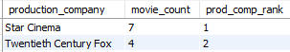
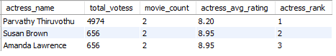
Data Analysis and Insights
27. The top two production houses that have produced the highest number of hits (median rating >= 8) among multilingual movies.
28. The top 3 actresses based on number of Super Hit movies (average rating >8) in drama genre.
Observation: Star Cinema and Twentieth Century Fox are the two production houses which had produced highest number of its..
Observation: Among actresses, Parvathy Thiruvothu is top actress for giving Super hit movies in drama genre..

Slide 17
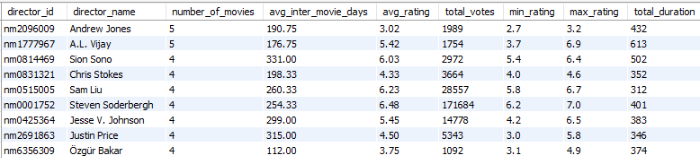
Data Analysis and Insights
29. The top 9 directors based on number of hits.
Observation: Andrew Jones was one the top 9 directors based on number of hits.

Slide 18
Recommendations
First RSVP Movies need to select the type of genre to produce. As drama genre produced highest in three years of 2017 to 2019.
Genre : Drama
Production house based on number of hit movies
Production House : Dream Warrior Pictures and National Theatre Live
Production house based on the number of votes received by their movies.
Production House : Marvel Studios, Twentieth Century Fox and Warner Bros
Actor based on movies have an average rating > 8.
Actor : Mammootty and Mohanlal
Actor based on weighted average based on votes.
Actor : Vijay Sethupathi and Fahadh Faasil
Actress based on weighted average based on votes (acted in hindi)
Actress : Taapsee Pannu and Kirti Sanon
Actress based on number of Super Hit movies.
Actress : Parvathy Thiruvothu, Susan Brown and Amanda Lawrence

Slide 19
Recommendations
The top 2 production company based on number of hits in multi-lingual are Star Cinema and Twentieth Century Fox.
Director based on movies have an average rating > 8
Director : James Mangold
Andrew Jones is in top directors with high number of movies with average inter movie days as 190.75 days.
Release in December month, Since December is the month with the lowest movie release market share as well as Christmas, New Year and many other holidays
Other crucial things required
Story / Screenplay / VFX / Music / Editors as a few different critical matters required however we couldn't have records to analyze.
They can decide based on genre/ directors/ actors/ actress / multi – lingual / other important things needed for producing the movies either in India / USA / Europe.

